Slide 1


DNA based Cryptography
Prof. Manish Gupta
ID: - 201901080
Name: - Tarun Boricha

Slide 2


Introduction
Cryptography has been shown recently as a new application of DNA Computing. Steganography means hiding of secret messages among other information to conceal their existence. Digital message is represented here in binary DNA showing in figure (1).

Slide 3
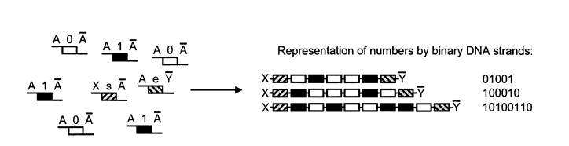
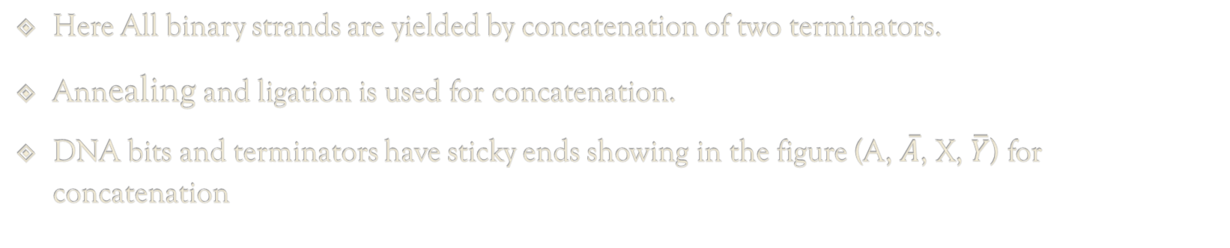
Figure (1)
Here All binary strands are yielded by concatenation of two terminators.
Annealing and ligation is used for concatenation.
DNA bits and terminators have sticky ends showing in the figure (A, $\overline{A}$, X, $\overline{Y}$) for concatenation
https://link.springer.com/chapter/10.1007/978-3-540-24635-0_12

Slide 4
DNA steganography
Mixing one binary strands with other DNA is called DNA steganography as it prevents reading the binary strands.
So, for encryption the information that corresponds to DNA binary strands is mixed with other DNA binary strands (dummy strands in equal amount) shown in figure (2).
For achieving strong security, the information strands and dummy strands should have same binary format.
For decryption key sequence that attached with information strands is required.

Slide 5
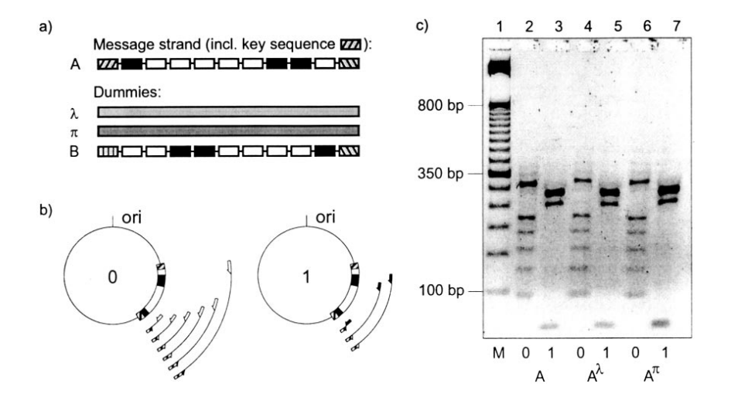
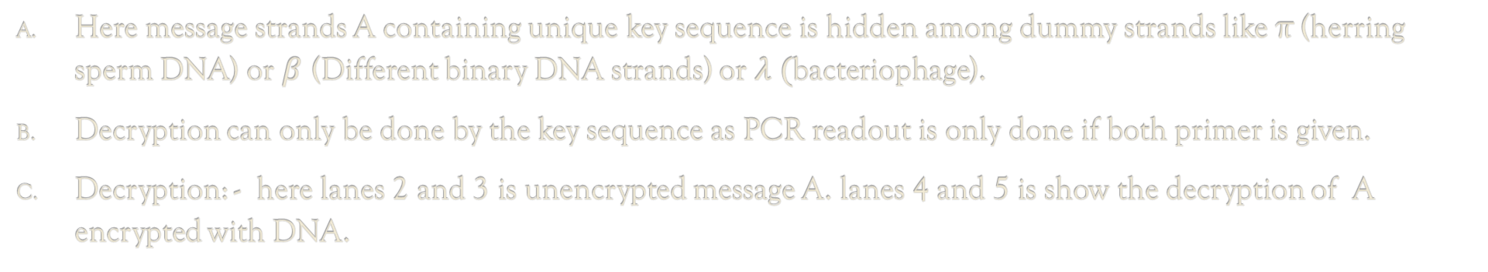
Here message strands A containing unique key sequence is hidden among dummy strands like π (herring sperm DNA) or $β$ (Different binary DNA strands) or $λ (\text{bacteriophage}$).
Decryption can only be done by the key sequence as PCR readout is only done if both primer is given.
Decryption: - here lanes 2 and 3 is unencrypted message A. lanes 4 and 5 is show the decryption of A encrypted with DNA.
Figure (2)

Slide 6
Algorithm for Encryption
Step 1: - Convert the plain text into the Binary format.
Step2: - We add unique key into the message at the start.
Step3: - Generating certain DNA dummies and put the DNA binary strands (message) along with it.
Decryption: -
For decryption we need unique key as the readout process is based on knowledge of both start and end primer.
The start primer is unique key and end primer is either 0 bit or 1 bit.
So, performing both 0 bit and 1 bit primer reaction we can easily decrypt message with PCR readout.

Slide 7
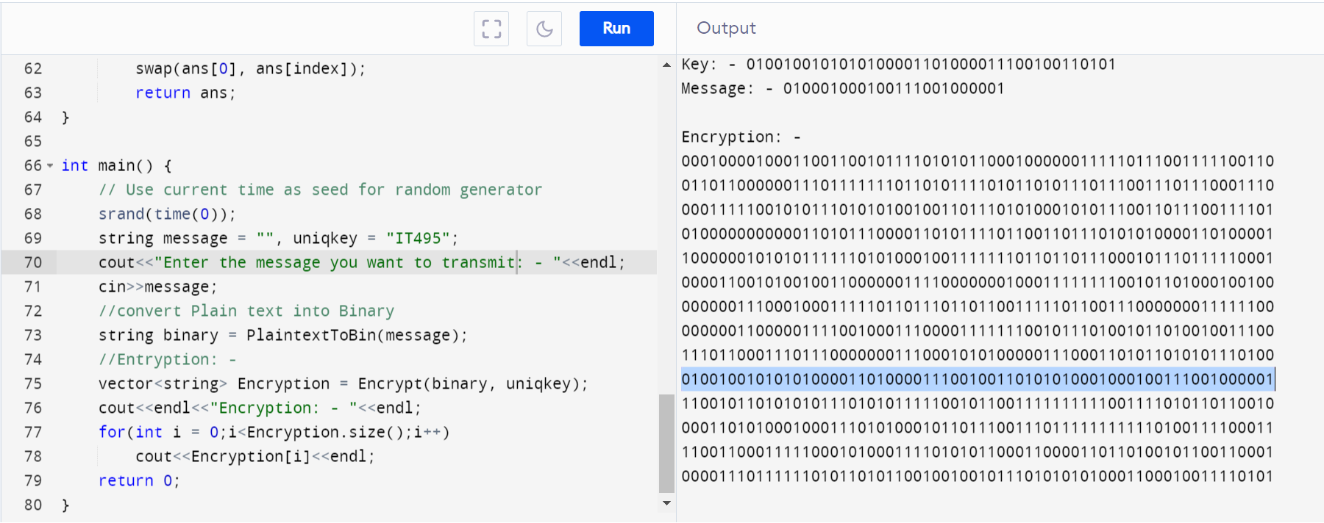
Algorithm: -

Slide 8
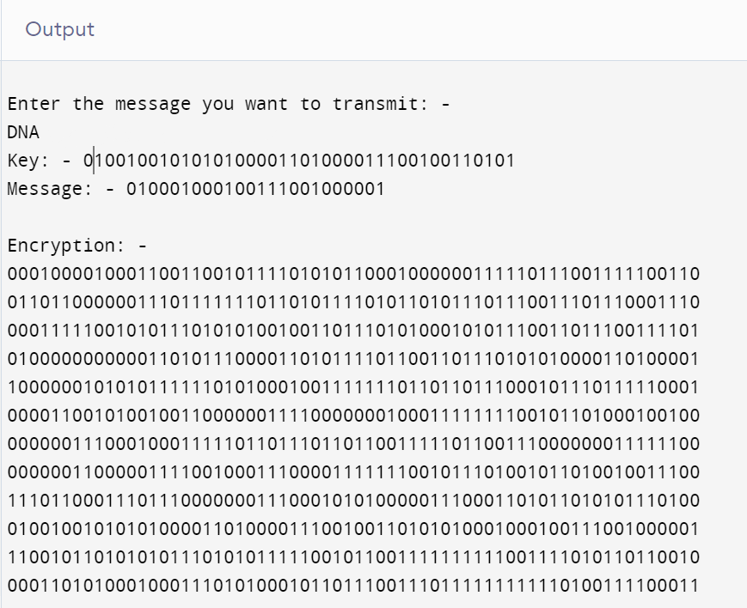
Algorithm Output: -
Other DNA dummies with same
structure as Message strands
DNA binary Message strands including key sequence at start

Slide 9


Security
Any single attack must not yield more information than a random extraction of one strand and its duplicates.
To achieve this all the dummies has same structure as message strands and other assumption is that DNA-coded messages, which follow a linguistic structure, by methods based on linguistic statistics must be prevented.
System specific security, case: -
Probability of $S_{T}$ and $S_{E}$ bind together is: -
$P= \frac{1}{{\left|B\right|}^{L}}$
Here B = $\left\{A, C, G, T\right\}\left(\left|B\right|=4\right)$
and L is normalized length of sequence

Slide 10
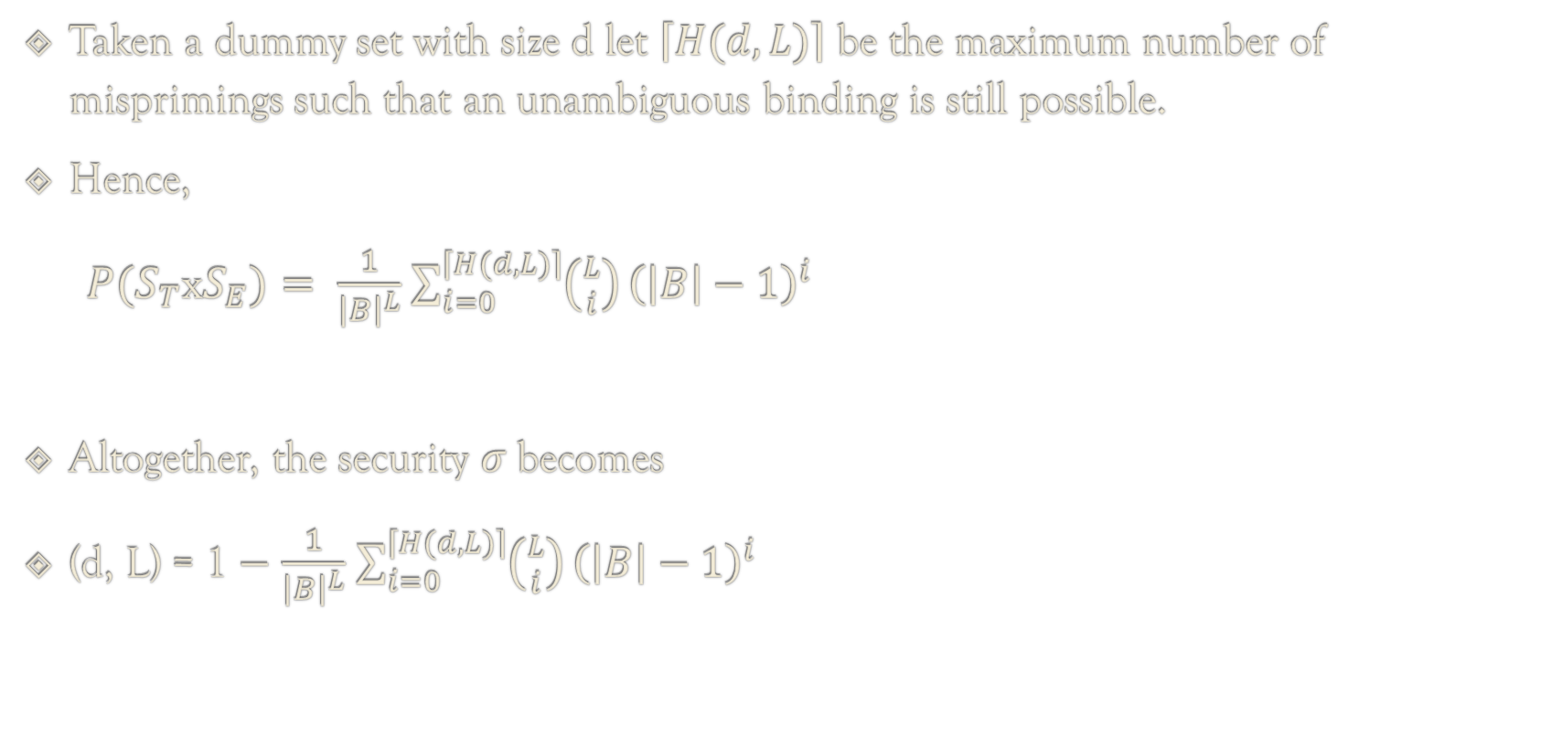
Taken a dummy set with size d let $\left\lceil H(d, L)\right\rceil$ be the maximum number of misprimings such that an unambiguous binding is still possible.
Hence,
$P(S_{T}\text{x}S_{E})= \frac{1}{{\left|B\right|}^{L}}$ $\sum_{i=0}^{\left\lceil H(d, L)\right\rceil }{\left({L \atop i}\right)}{\left(\left|B\right|−1\right)}^{i}$
Altogether, the security $σ$becomes
(d, L) = 1 $−$ $\frac{1}{{\left|B\right|}^{L}}$ $\sum_{i=0}^{\left\lceil H(d, L)\right\rceil }{\left({L \atop i}\right)}{\left(\left|B\right|−1\right)}^{i}$
here, $\left({L \atop i}\right){\left(\left|B\right|−1\right)}^{i}$ is number of sequences $S_{T}$ with hamming distance i

Slide 11
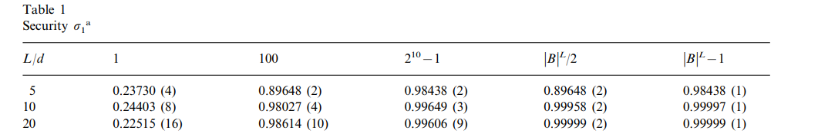
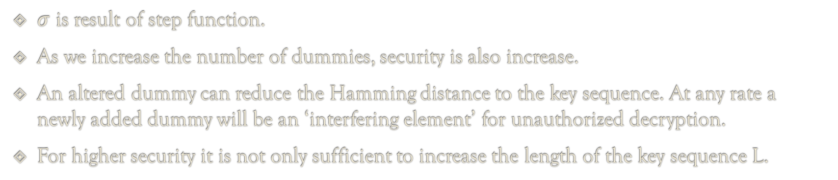
$σ$ is result of step function.
As we increase the number of dummies, security is also increase.
An altered dummy can reduce the Hamming distance to the key sequence. At any rate a newly added dummy will be an ‘interfering element’ for unauthorized decryption.
For higher security it is not only sufficient to increase the length of the key sequence L.
https://www.researchgate.net/publication/12357909_Cryptography_with_DNA_binary_strands

Slide 12
Conclusion
Here it is proven that DNA steganography based on DNA binary strands is secure but on following condition that an interceptor has the same technological capabilities as sender and receiver of encrypted information.
Using only PCR and subsequent gel-electrophoresis Decryption is easier and more rapidly while subcloning and sequencing is not necessary.

Slide 13
References
Adleman, L.M., 1994. Molecular computation of solutions to combinatorial problems. Science 266, 1021–1024.
Clelland, C.T., Risca, V., Bancroft, C., 1999. Hiding messages in DNA microdots. Nature 399, 533–534.
Gehani, A., LaBean, T.H., Reif, J.H., 1999. DNA-based Cryptography. In: 5th DIMACS Workshop on DNA Based Computers, MIT, June, 1999.
Graham, R.L., Knuth, D.E., Patashnik, O., 1990. Concrete Mathematics. 6. Addison–Wesley, Reading, MA print, with corr.
Guarnieri, F., Fliss, M., Bancroft, C., 1996. Making DNA add. Science 273, 220–223.
Jeffreys, A.J., MacLeod, A., Tamaki, K., Neil, D.L., Monckton, D.G., 1991. Minisatellite repeat coding as a digital approach to DNA typing. Nature 354, 204–209.
Schneier, B., 1996. Applied Cryptography, second ed. John Wiley, New York.
Winfree, E., Liu, F., Wenzler, L.A., Seeman, N.C., 1998. Design and self-assembly of 2-dimensional DNA crystals. Nature 394, 539–544.

